Slide 1
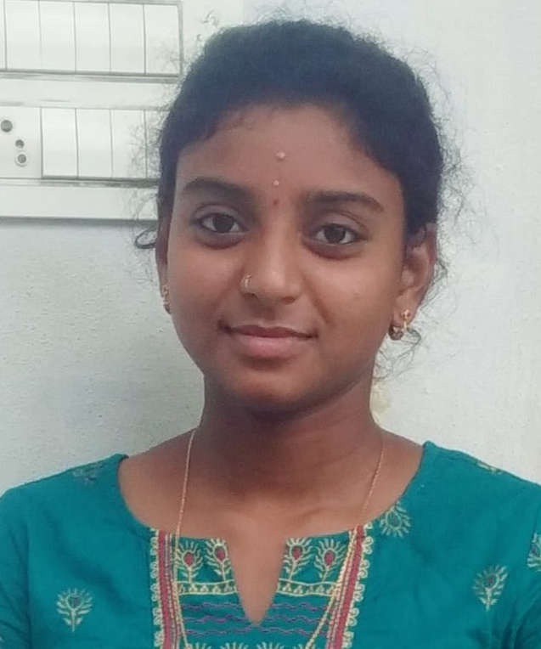


Pushpa Muddana
Education and certificates
srinivasa institute of engineering & Technology, amalapuram.
Electronic&Electrical Enfineering,batchelor of technology
2017-2021
Analyst/Software Engineer
Base Location: Mumbai
MUDDANA-PUSHPA-VENKATA-RAMYA.VANI@CAPGEMINI.COM
+91-9573535178
Skills
Email ID: Mobile No:
Java | Java Basics, OOPS, Generics, Collections, Arrays.
Framework | Spring Core, Spring Boot, Spring Data JPA, Spring Data REST.
Database | PostgreSQL, MongoDB
Tools | Git, Postman, Visual Studio Code, Eclipse, PgAdmin 4.
Frontend | HTML, CSS, Bootstrap JavaScript, React
Grade:
A4
Strengths
Spring Project
Full Stack Developer trained on Java Hands on experience on
NAME BOARD GIFT SHOPE
By using this Name Board Gift Application People around the world can order and gift their precious Gifts to their loved ones .They can find unique and standard quality designs gifts and order the customized design , A gift or a present is an item given to someone without the expectation of payment or anything in return.
Git and GitHub.
MongoDB & PostgreSQL.
Core Java.
JPA with Hibernate.
Spring Framework.
HTML 5, CSS 3, Bootstrap, JavaScript
React.
React Project
Note Making System
This application is built to help customer to keep their note updated. User can save and delete the note. It is easy to use.
.

